Slide 1
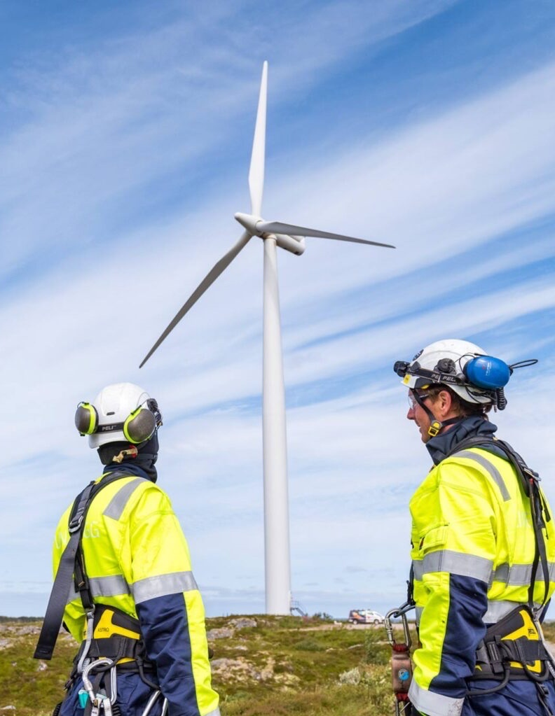
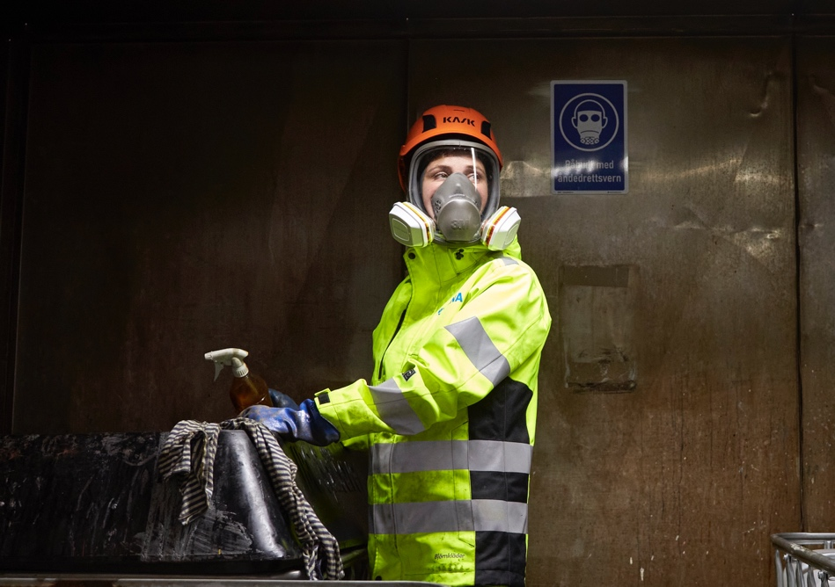
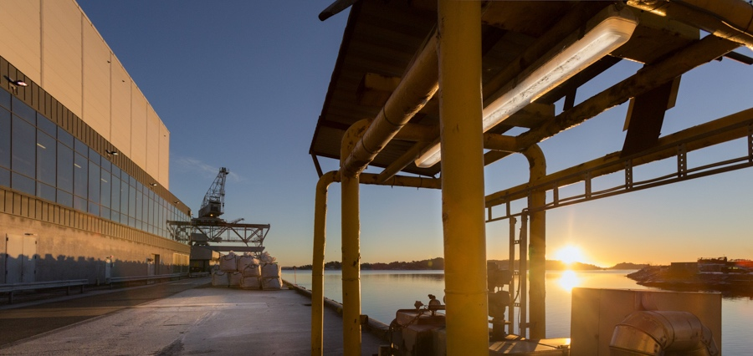
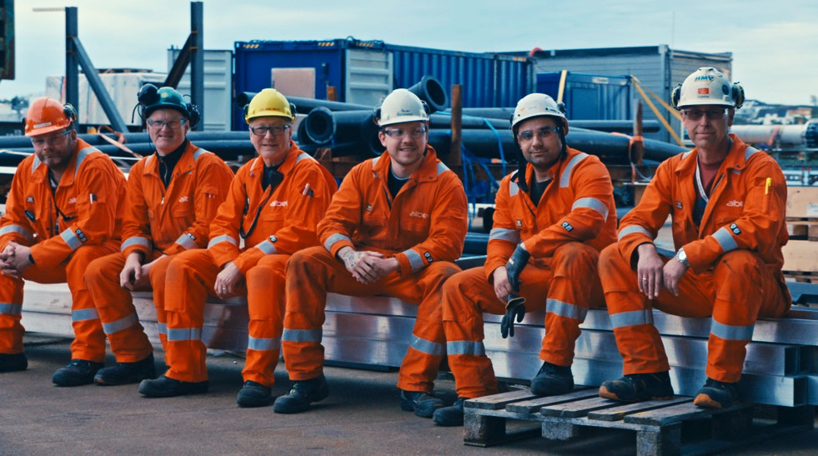
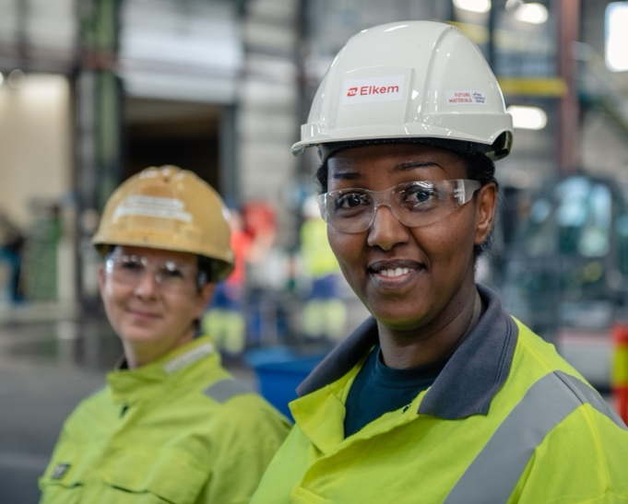
Safety, leadership and learning
- A practical guide to HOP
Notes:
Message:
Human organisational performance (HOP) is about having a systems perspective on safety work. This means that instead of looking at what people are doing (focus on the individual), we try to understand the conditions that influence what they do (focus on systems). What conditions can make the work more difficult or easier to do, and how can we identify and deal with these conditions?
Human Organizational Performance (HOP) is a field and an approach that not only Norsk Industri, but the entire industry internationally, has focused more on in recent years. It is not a new initiative, but a further development of the way we work with safety and a tool to solve the tasks we are already doing today.
About this presentation:
We have included information on some of the slides (speakers notes) that we recommend you to use. This is intended to support you, but is not a script telling you exactly what you should say. It is important that you make the presentation your own and that you think through examples and content that are relevant to the target group. Leaders will probably have different needs than employees. In addition, there will probably be differences between those who work in operational environments compared to, for example, those who work in staff and support functions in the company.
Each slide may contain one or more of the following in speakers' notes: 1. Message: key points to supplement content on the slide. 2. Reflection: Examples of questions you can ask the target group to involve them. 3. About the slide: Additional information about the content and how to use the slide that may be relevant.

Slide 2
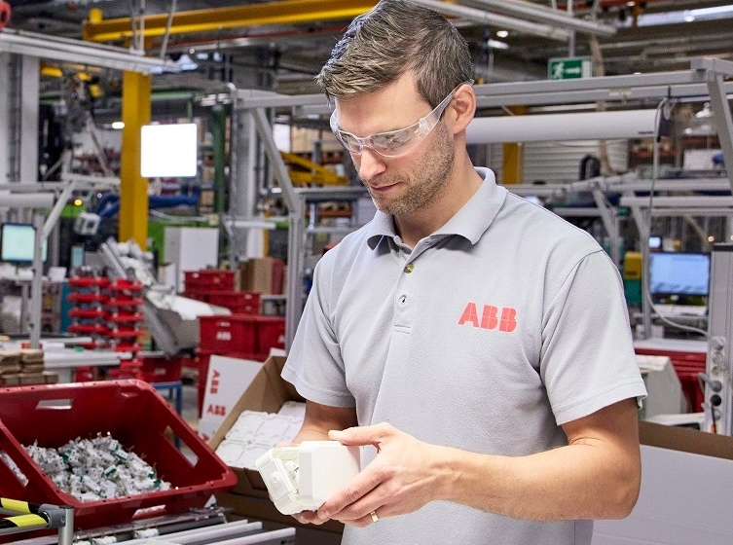
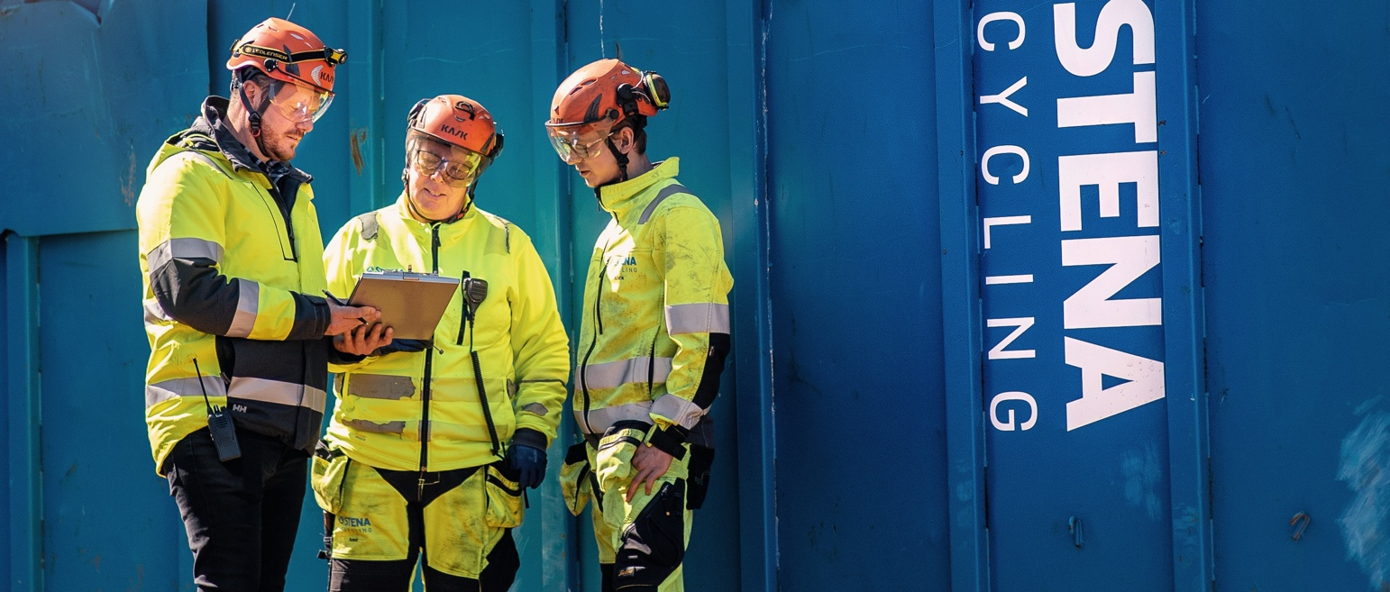
OVERVIEW
What is human organisational performance (HOP)?
Why is it important?
How do we do it in practice?

Slide 3
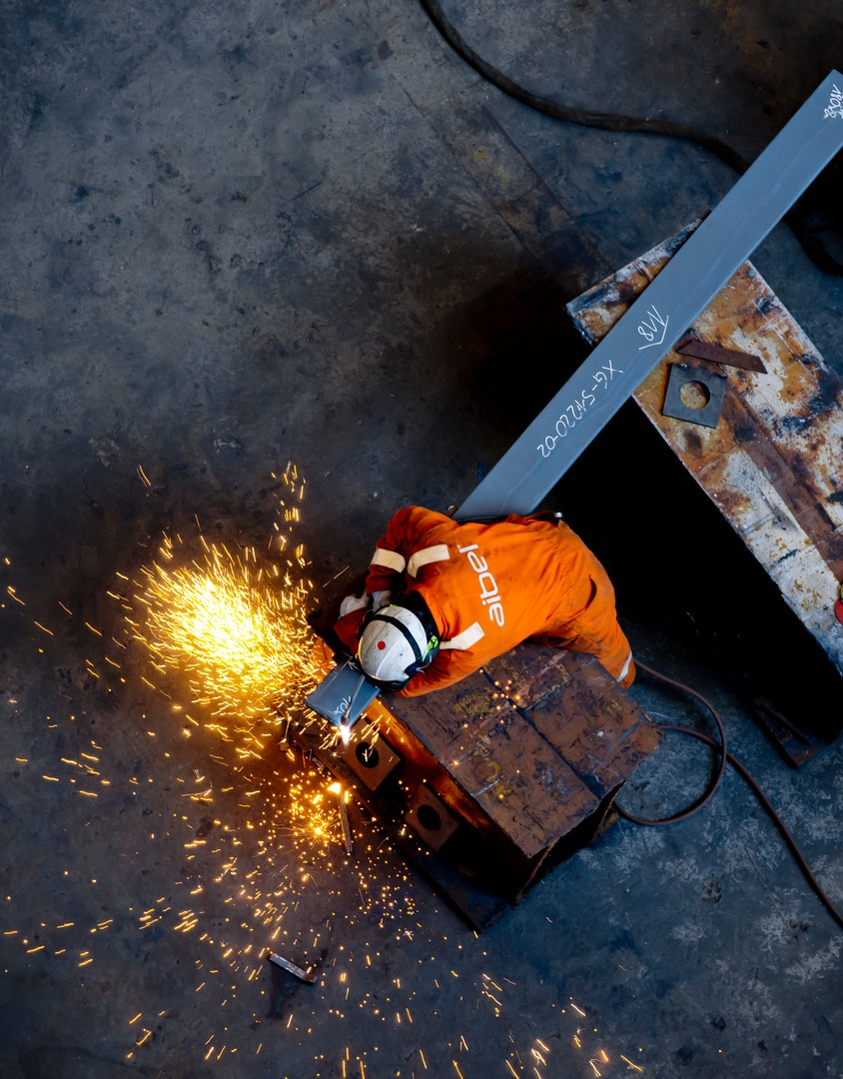
We have gone from being one of the most dangerous industries to being one of the safest, but the improvements have slowed down and the curve is flattening.
INCIDENTS
TIME
Notes:
Message
We have done a lot of good work that has improved safety in the industry over time, in the form of e.g. regulations, requirements and procedures, work processes and focus on compliance and personal commitments.
Why has the improvement now slowed and the curve flattened? We know that following procedures and requirements, and individual commitments are very important for safety, but we also see that it is not enough to improve further from where we are today.

Slide 4
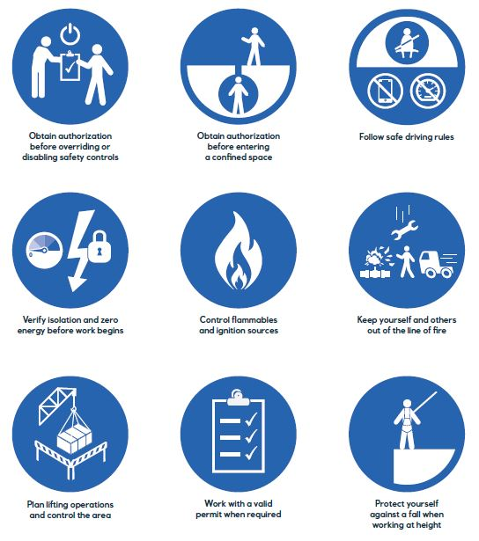
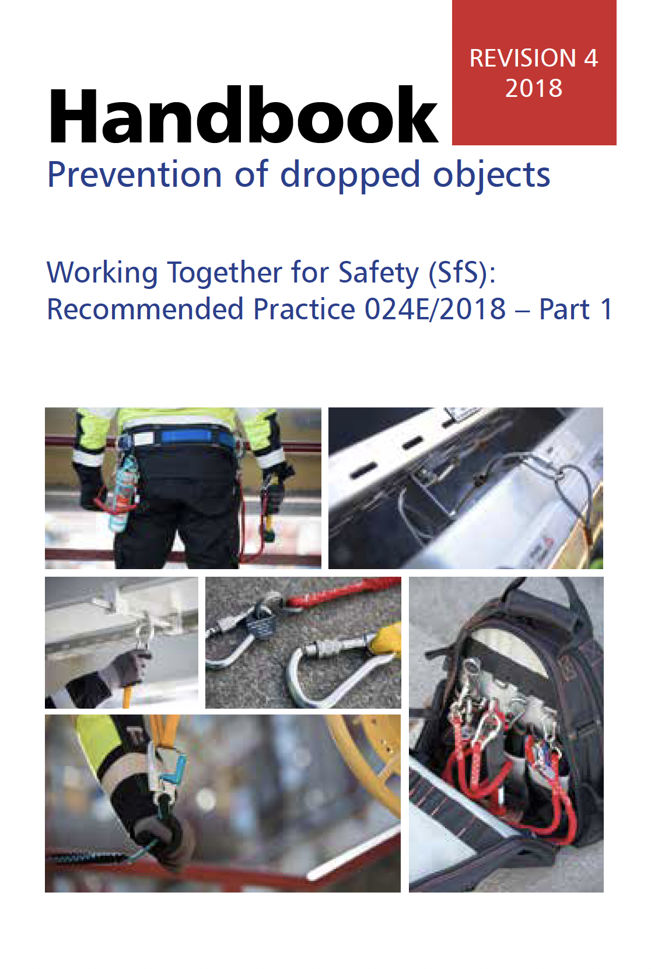
REFLECTION
Why aren’t rules and requirements enough to achieve good safety?
Notes:
Message
Requirements and rules are very important because they describe good practice for safety. Following requirements and rules is always desirable. Some requirements and rules may be clear and specific, with little room for interpretation (holding the railing, using protective equipment, etc.), but often requirements and rules must be adapted to the situation in which they are used. The texts in requirements and rules can be interpreted differently and used differently. Facilities and installations are also designed differently. It is not possible to have requirements and rules that describe all situations or everything that can happen for each individual operation. We will always have to make decisions and make adjustments that involve varying degrees of uncertainty.
Reflection
Why are not requirements and rules enough to achieve god safety?
About the slide
Primarily, we want you to invite the target group to reflect on the question on the slide. Start by asking for their reflections/input on the question. If no one shares, you can e.g. Ask: "John, what do you think?". Use positive reinforcement when you receive feedback. "Yes, being focused or present is important. Do you have other input? Anne, what do you think?” We want to convey that we cannot solve the challenge we are facing with a "perfect" management system that takes everything into account. This will result in a very comprehensive and unclear management system, which will still not cover everything.
If you do not have time to involve the target group due to time constraints, you can use the content under "message" as supplementary information for the slide.

Slide 5
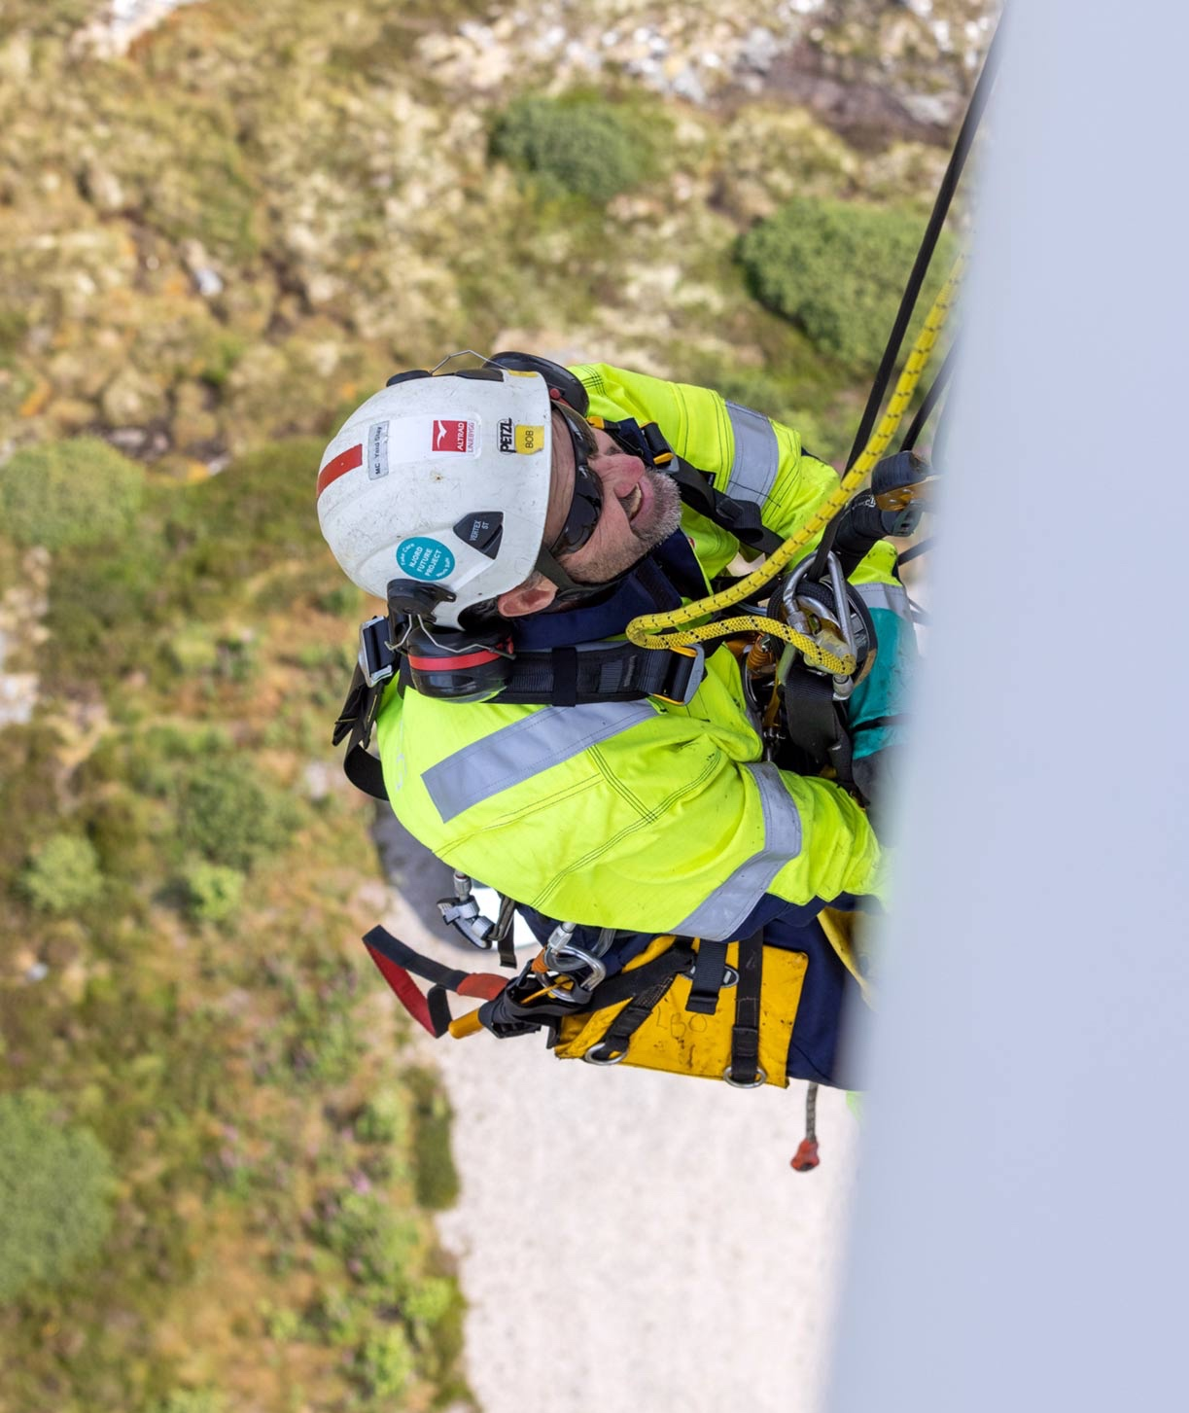
BACKGROUND
Safety, leadership and learning is based on Human Organisational Performance (HOP) and is a further development of our existing approach to safety.
The HOP principles:
People make mistakes
Blame fixes nothing
Learning is the key to improvement
Context drives behaviour
How we respond matters

Slide 6
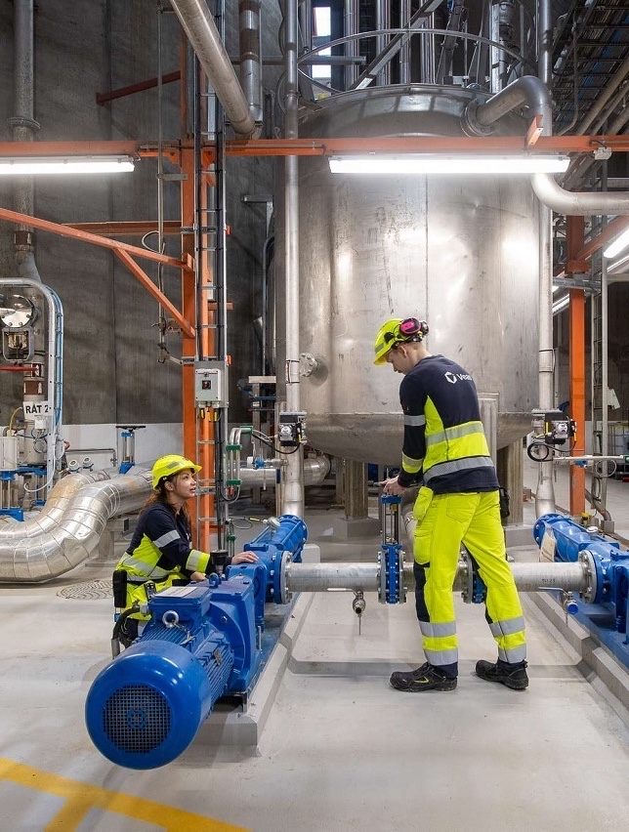
We have a tendency to focus on the individual
Not present
Experience
Shortcuts
Attitudes
Risk perception
Lack of rest
Misinterpretation
Poor cooperation
Boredom
When we talk about the reasons why requirements and procedures are not followed, or why mistakes are made, we often talk about conditions related to the individual(s) performing the work.
Notes:
Message
We tend to focus on the individual when we talk about reasons for non-compliance and failure. Those who do the work are not "present or aware", they take shortcuts, they interpret information incorrectly, etc.
About the slide
Follow up the input that came from the target group on the reflection question on the previous slide. Perhaps they mentioned a number of examples focusing on the individual and which are mentioned on the slide? The purpose is to get them to go from a a focus on the individual to a more system focus. This will be addressed in the next slide.

Slide 7
PEOPLE MAKE MISTAKES
We must ensure that we have good systems that remove or minimize the chance of errors, and that the consequences of the errors that do occur are minimal.
Notes:
Message
If we only focus on the individual, we become vulnerable. We must recognize that mistakes and wrongdoing are part of our human nature. Therefore, we must reduce the probability of errors, but also ensure that we have systems that reduce the consequences of the errors that do occur.
About the slide
"People make mistakes" is the first principle of the Human Organizational Performance approach.

Slide 8
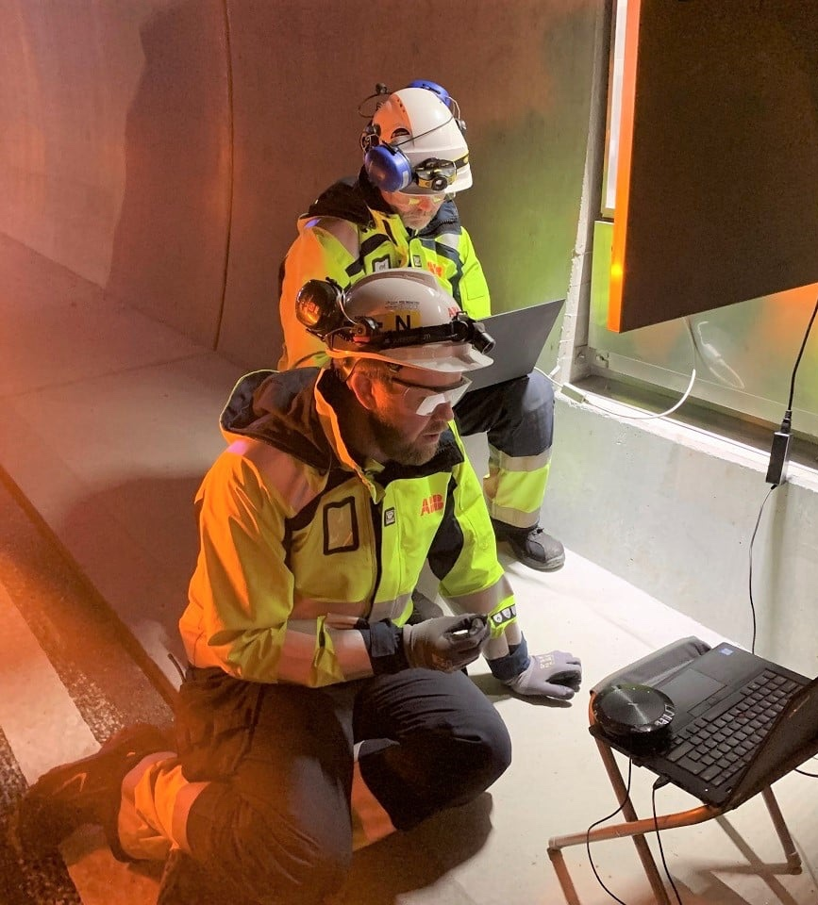
We need to focus more on the systems we work within
Unclear roles / responsibilities
Complex tasks
Inadequate documentation
Low staffing
Lack of training
Unsuitable tools / Equipment
Inadequate planning
Communication problems
Poor access
Time pressure
Lack of rest
Equipment / system error
Our choices and actions are influenced by the conditions around us. We have to understand how people, technology, work processes and organisation work together. How can we improve this interaction?
Notes:
Message
Everything we do is affected by the systems and conditions around us. The choices we make and the way we work are governed by what seems reasonable under the circumstances. There may be poor access to carry out the work, there may be important deficiencies in documentation, and there may be new colleagues who have little or no experience with the work operation and lack training. Therefore, we need to better understand how people, technology, work processes and organization work together. We need to focus more on the systems around the people.
About the slide
All the examples on the slide refer to circumstances beyond the individual that can increase the likelihood of mistakes or wrongdoing. The examples in the slide are at system level.

Slide 9
Focus on individuals and blame stops learning and improvement
FROM REACTIVE BLAME CULTURE
TO PROACTIVE LEARNING CULTURE
Those who do the job are a problem that has to be controlled so that the job gets done in a precise and safe manner
Those who do the job are a resource that should be used to find
a precise and safe way to do the job
Focus on the choices and actions of the individual
-
In case of errors or incidents: Focus on guilt and responsibility
Focus on what influences people’s choices and actions
-
In case of errors or incidents: Focus on the contributing conditions (how)
Reduced trust and fear of consequences lead to less
sharing of information and concerns
Increased trust and motivation strengthens the culture for speaking
up and sharing information and concerns
We are less informed about conditions that require improvement, error traps are not detected, and errors and incidents continue to occur
We are better informed about conditions that require improvement, error traps are identified and managed, and fewer
errors and incidents occur

Slide 10
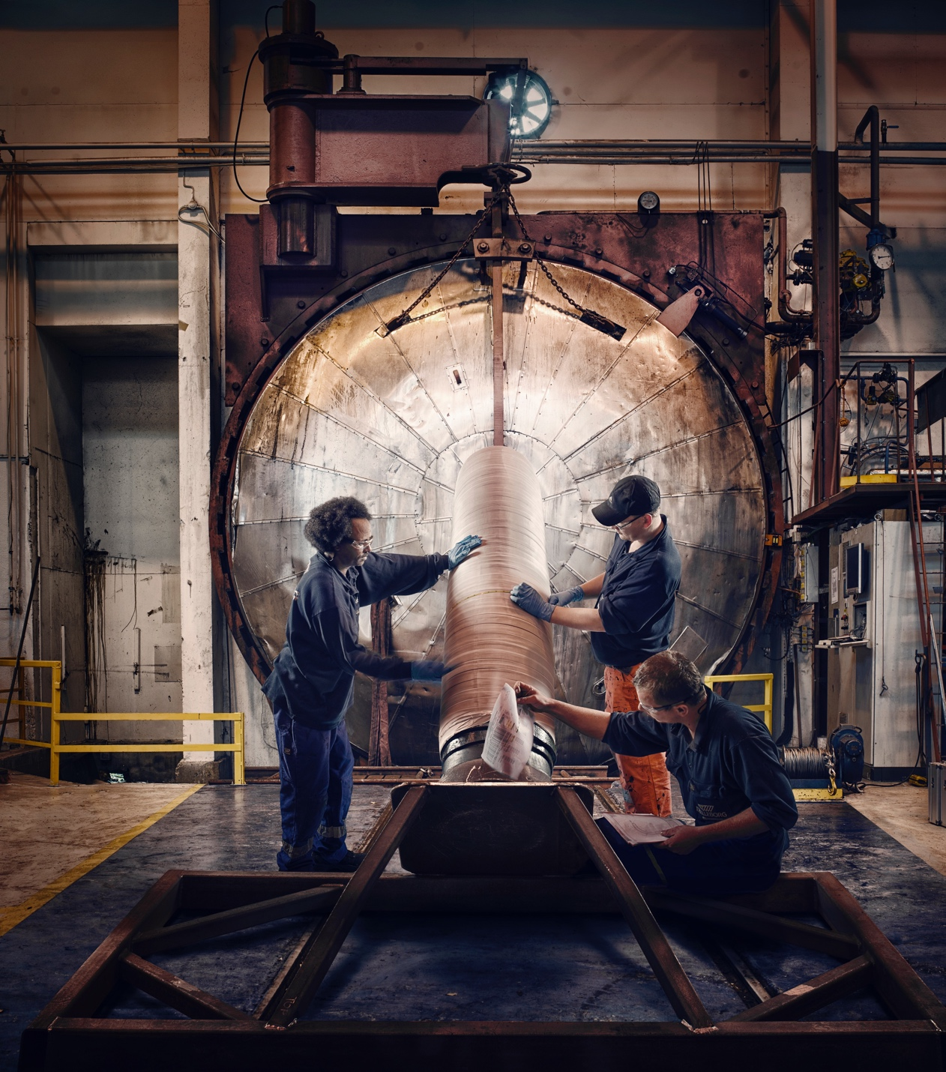
From procedure to practice
Procedures and requirements exist to ensure that the work we do is performed in a precise and safe manner.
REFLECTION
What changes from week to week where you work?
Notes:
Message
Procedures and requirements exist to ensure that a work operation is carried out in a precise and safe manner in order to achieve the goal that has been set.
Reflection
What changes from week to week where you work?
First ask the target group to give input on the reflection question on the slide. If they do not participate, you can, for example, ask the question to a specific person: "Line, what do you think?". It is an advantage that you think through your own examples that you can present or use to get the group started.
For example: Imagine that you are going to carry out a lifting operation (or other work operations you know well). If you are going to perform the same type of operation two days in a row, do you perform it identically both times? Why not? What creates different challenges with such operations?
About the slide
On the slide you see a line from procedure to practice. The line represents work as defined in work processes, technical requirements, standards, procedures or contracts. The line you see describes that "the map and the terrain" are identical. What is on "paper" is carried out as described. But is that how it works in reality?

Slide 11
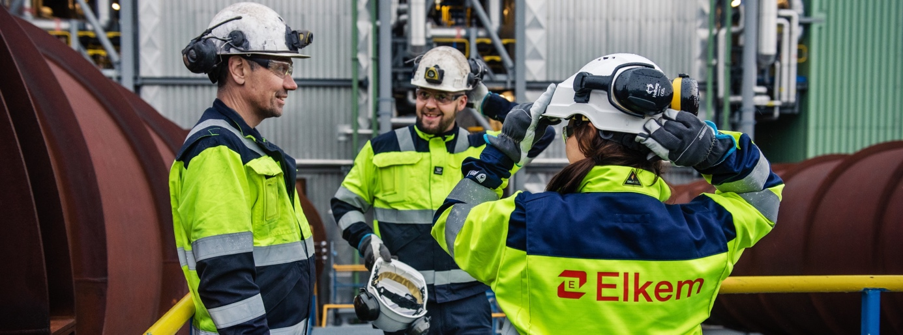
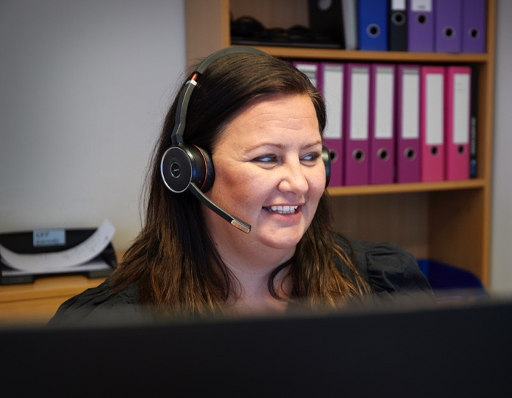
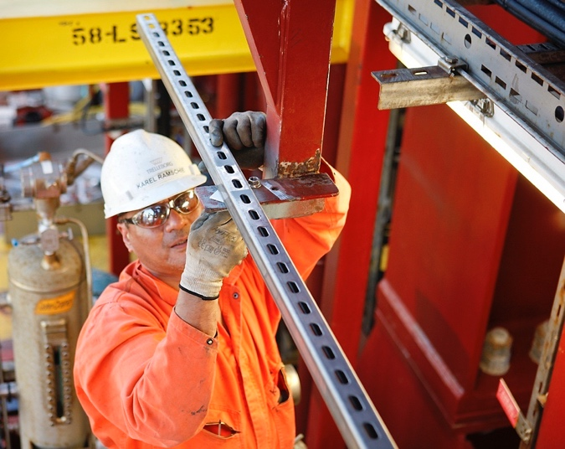
From procedure to practice
Work is performed under varying conditions and we make various adjustments to solve the task.
Notes:
Message
How work operations are actually carried out will vary for various reasons: those who carry out the work may have different backgrounds and experiences, there may be differences between shifts, or different installations and facilities; those who do the work adapt what they do to the situation they are in and the understanding they have of the task and what needs to be done. Days are not the same. It is natural that there are variations in the work that is carried out because different conditions can get in the way of following requirements and procedures. Humans are problem solvers who like to get the job done. This variation is not normally a problem, and can also lead to us finding good solutions.
About this slide
In addition to the line that goes from procedure to practice, you now also see a line that shows how work is actually done. This variation is the adaptations you make to get the job done. The variation you see above the line means that adjustments you make have contributed to making your work safer, easier or better. The variation you see below the line is also adaptations we make to get the job done, but contributes to an increased risk of an incident.

Slide 12
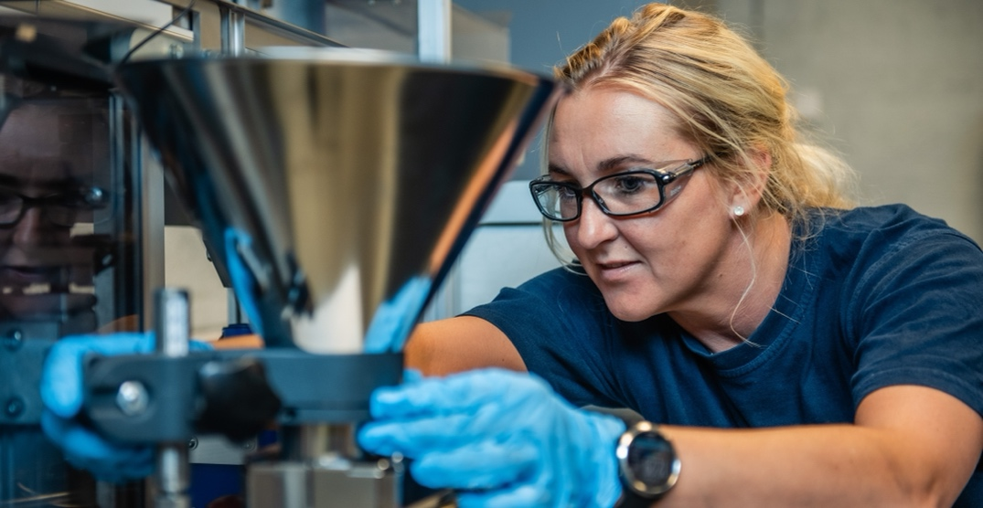
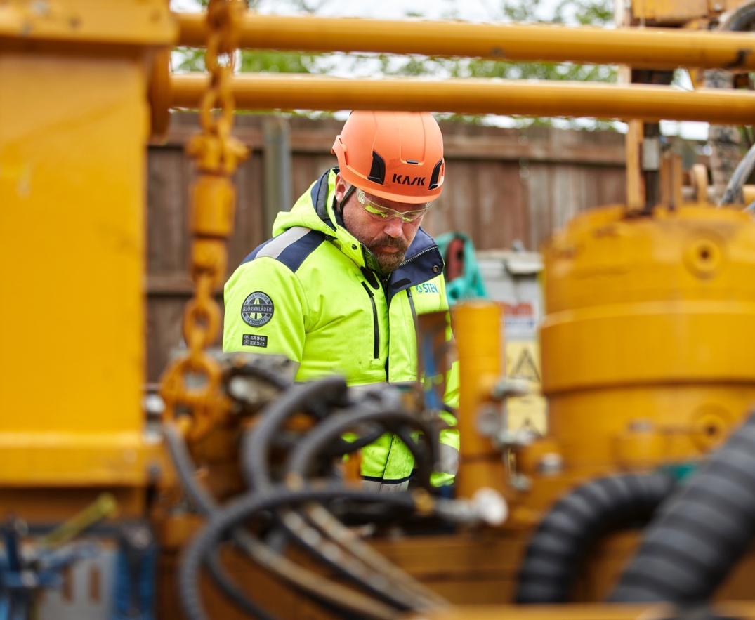
From procedure to practice
When the gap between procedures, requirements and practice becomes too large, the risk of incidents increases. Therefore, we must understand how work is actually done and which conditions create variation.
Notes:
Message
Small variations can provide an opportunity to learn and improve. But sometimes the variation or deviation from procedure can be too great, and if you fail to identify and handle this, it can contribute to an incident. Circumstances that can create variation can e.g. be unclear procedures, weather and wind, training, unsuitable tools, errors or insufficient staffing, or complex tasks. It is therefore important that leaders are out in the field and understand the job to be carried out, conditions that can make the job difficult, and what is needed to make it easier. We must understand and manage variation in work.

Slide 13
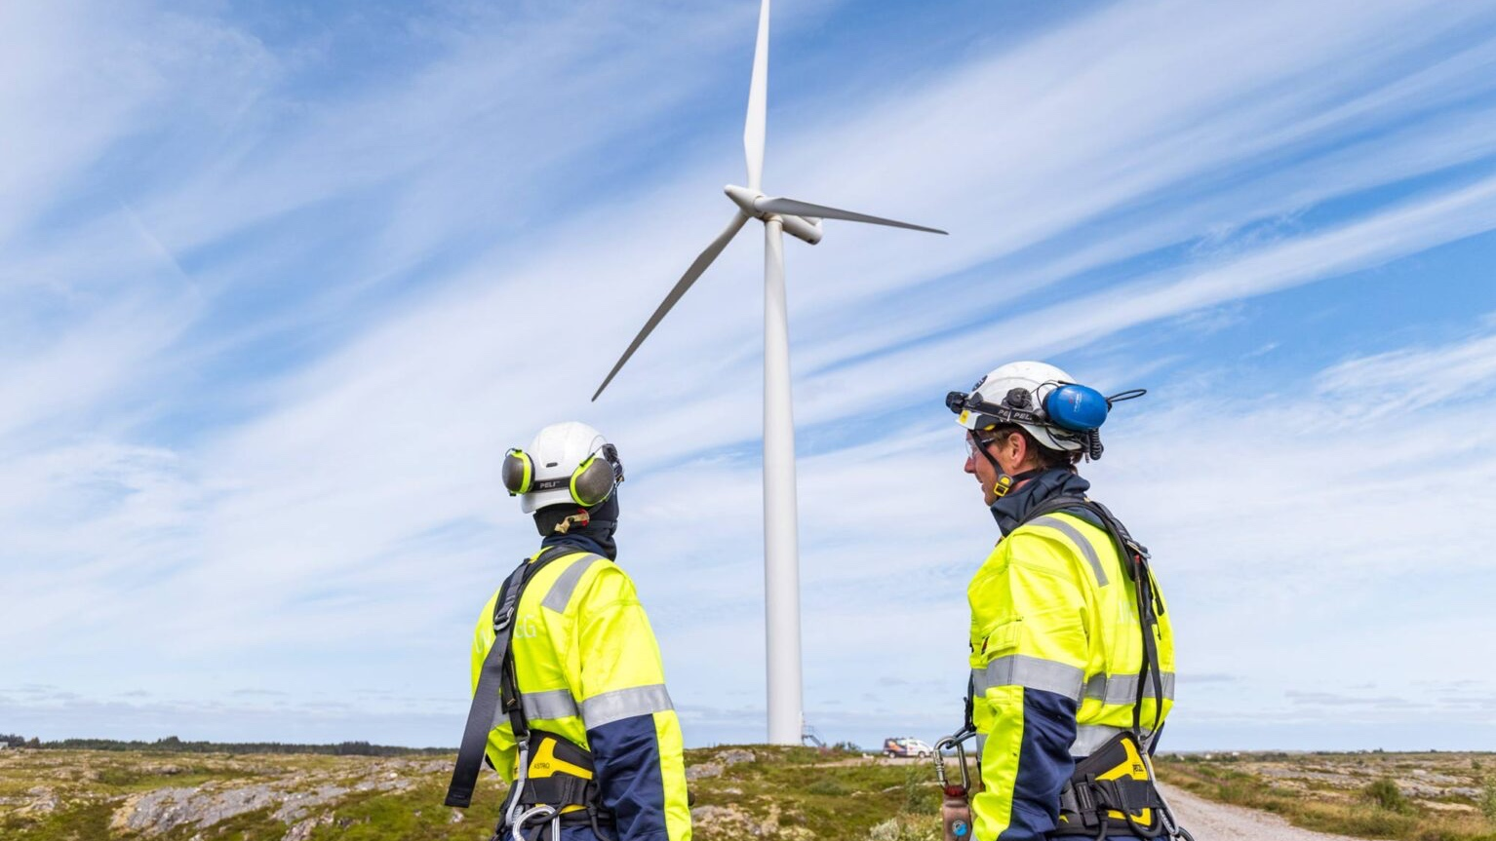
ERROR TRAPS
Error traps are conditions that make it difficult to follow procedures and requirements, and to work safely.
Notes:
Message
Error traps are all the conditions that contribute to increasing the probability of errors and wrongdoing, and which can increase the consequences. That means we have to move from focusing on what people do wrong to focusing on how we can identify the error traps that affect our work, so that we can learn and improve the surrounding systems.
A system of error traps will often result in near-misses and deviations that become apparent over time. Proactive leadership is trying to take out the learning of these signals in the form of changes that improve the system.

Slide 14
Examples of error traps
Organisational error traps
Task-based
error traps
Technical error traps
Individual
error traps
Unclear roles and responsibilities
Task conflicts
Problems with communication/ collaboration
Staffing and resource management
Organisation of work (e.g. workload and planning)
Unknown tasks
Unpredictable tasks
Complex tasks
Too little time
Trivial or repetitive tasks
Equipment or system failure
Deficiencies in documentation (e.g. incomplete, outdated)
Unclear instructions, labelling or signals
Unsuitable equipment
Poor access
Noise, lighting conditions, temperature, air quality
Lack of training/competence
Lack of experience
Lack of rest
Health problems
Stress
Notes:
Message
We can divide the error traps into four different categories. Three of them are on the system level. These are organizational error traps, task-related error traps, and technical error traps (here the presenter can choose to mention the examples on the slide or choose other relevant ones that the target group is well familiar with).
The last category is individual error traps. We tend to focus on the individual level, but in order to facilitate precise and safe job performance we must also understand the system around the people. We often see that the individual error traps are closely linked to other error traps, such as a lack of competence and unclear roles.
About this slide
The examples of error traps are taken from the guide dealing with error traps. Feel free to make the target group aware of the resource. The guide explains what error traps are, gives examples of different types of error traps, and advice on how to go about identifying and dealing with error traps.

Slide 15
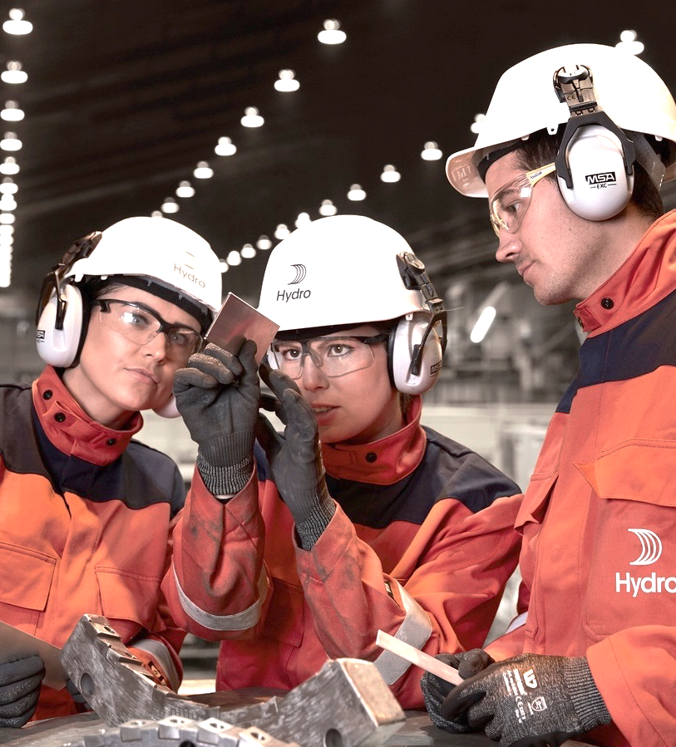
REFLECTION
Unclear roles / responsibilities
Complex task
Inadequate documentation
Inadequate early planning
Communication problems
Unsuitable tools / equipment
How common or uncommon is it to face challenges like these in our work?
Notes:
Reflection
How common or unusual is it to face challenges like this in our work?
About this slide
This slide and the next two slides are connected. The point of these slides is to show that the error traps that become more visible after incidents are often present in normal work (when there are no incidents). We use an incident from Johan Sverdrup to illustrate this. As a presenter you are welcome to replace this example with another that you and your target group know well, but it is important that you use the same build up.
If you don't have time to involve the target group, you can use one or two of the points on the slide as a starting point to give examples from your own work.

Slide 16
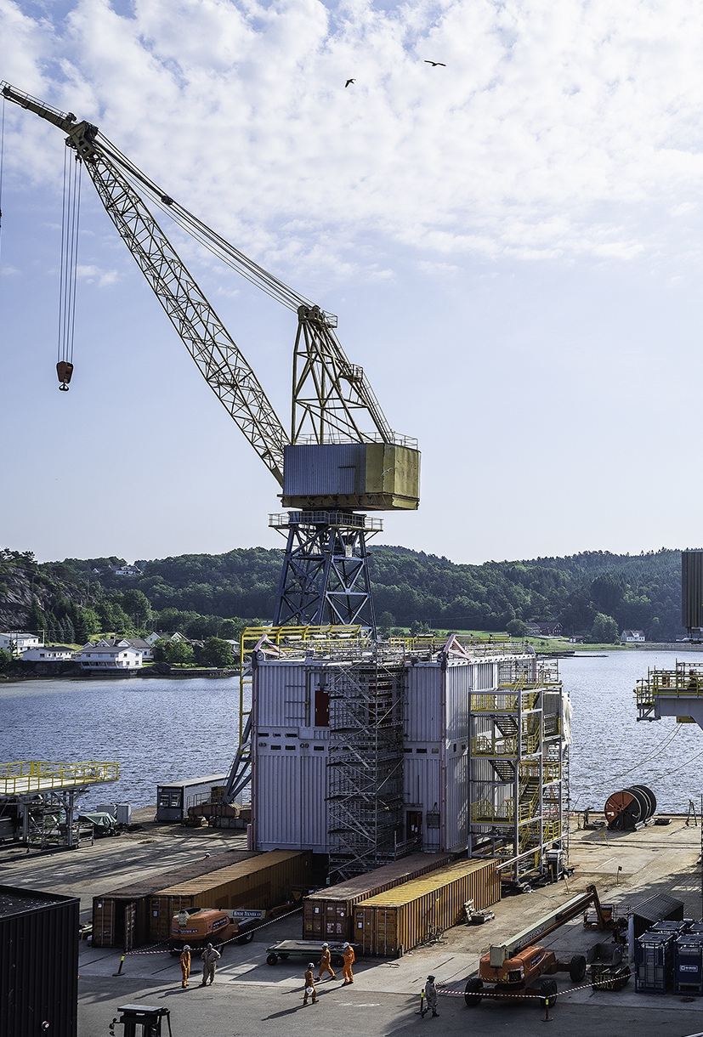
Unclear roles / responsibilities
Complex task
Inadequate documentation
Inadequate early planning
Communication problems
Unsuitable tools / equipment
Together, these conditions led to an incident in which a person suffered a serious crushing injury during a lifting operation.
Notes:
Message
As you can see, it was the same conditions or error traps on the previous slide that led to a person suffering a serious crushing injury during an offshore lifting operation in 2021.
About this slide
Additional information about the personal injury during lifting operation:
The incident occurred while lifting part of a gangway. The work team had attached lifting chains to the footbridge structure. They freed the structure from a chemical ramp by loosening the first of two load securing straps. The structure was then held up by the crane hook in which the lifting chains hung, as well as the last load securing strap.
When the first strap was released, the structure began to shift. At the same time, one of the slingers moved into the lift zone.
The person was crushed between the structure and a chemical ramp.
The most important point to communicate is that there were existing conditions at system level that contributed to the incident being able to happen.

Slide 17
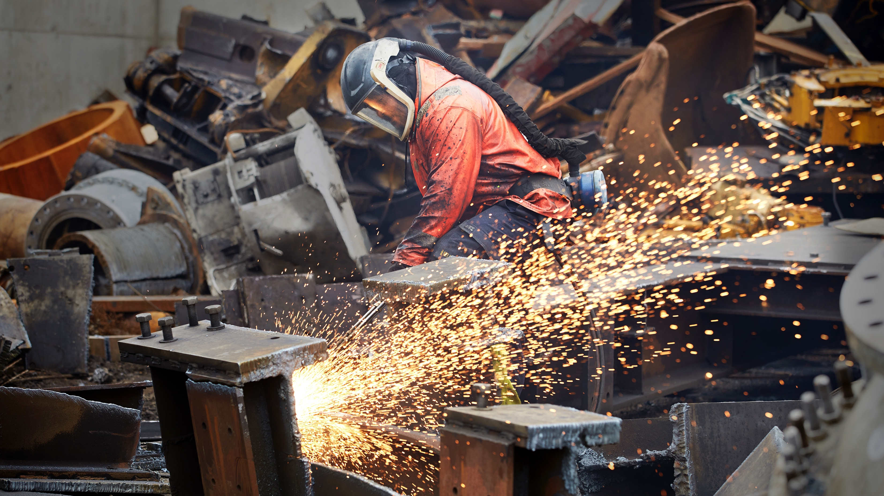
Many of the same conditions that become visible after an incident are also present when the job is going well.
Notes:
Message
An event rarely occurs due to completely unique conditions that we have never seen before. It is most often a combination of normal challenges or error traps that lie behind the events that occur.
If we only focus on learning from incidents, we limit all the learning opportunities that lie in all those jobs where, after all, things are going well. We become reactive instead of proactive. Learning opportunities also becomes fewer.
About this slide
You can use the slide as a sort of preliminary summary of the section you have just been through.

Slide 18
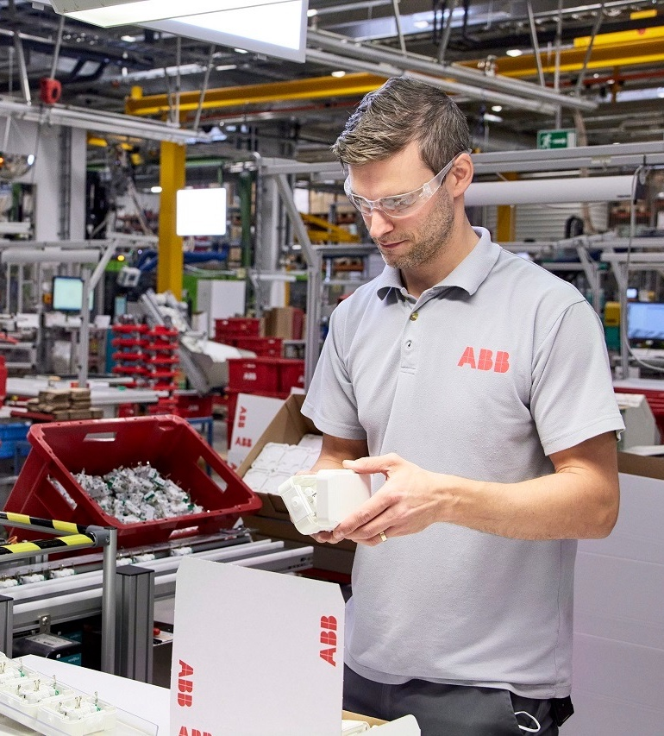
We have to learn from normal work before an incident occurs.
Notes:
Message
Learning from normal work before an incident occurs is about learning from what people do as part of the job (carrying out a lift, working at height, working on pressurized systems, etc.) on a daily basis. Every time you do this job, there may be something about the situation that is different:
The weather is worse
You have less time to do the job
Illness in the team
The right tools are not available there and then
Apprentices who have not done the job before
More people in the work area
Every day there is something different and those who work complete the work under these varying conditions. This is what we call normal work. The error traps that become visible after an incident have often been present in normal work (before the incident) as well. If we become good at learning from normal work, we can handle the error traps and prevent unwanted incidents. Learning becomes proactive and not reactive.
We must move away from the mindset that the absence of incidents means that we are working safely.

Slide 19
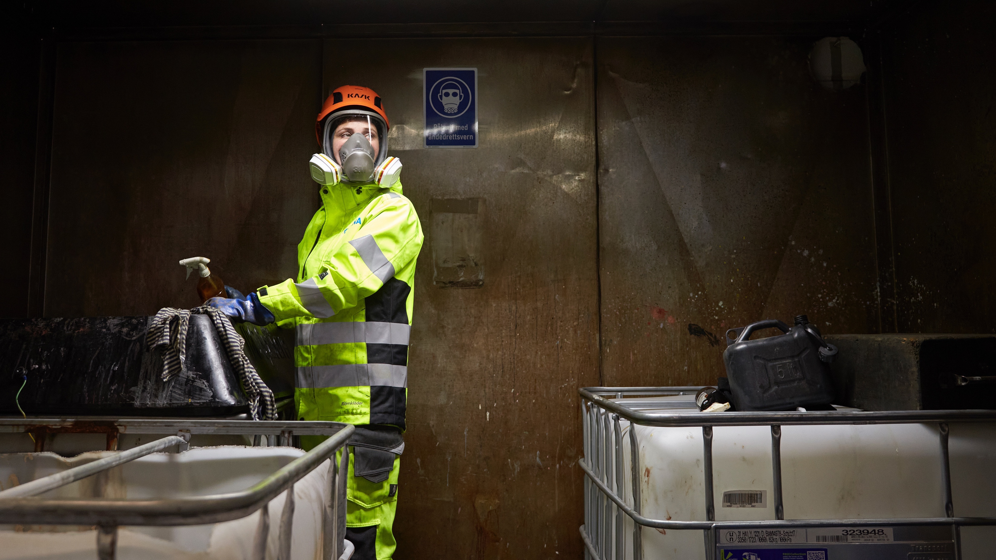
Learning from incidents is an important part of our safety work. But the majority of the jobs we do go well!
How can we work actively to make use of
the learning potential in these jobs?
Notes:
Reflection
You can use the text and question on the slide to involve.

Slide 20
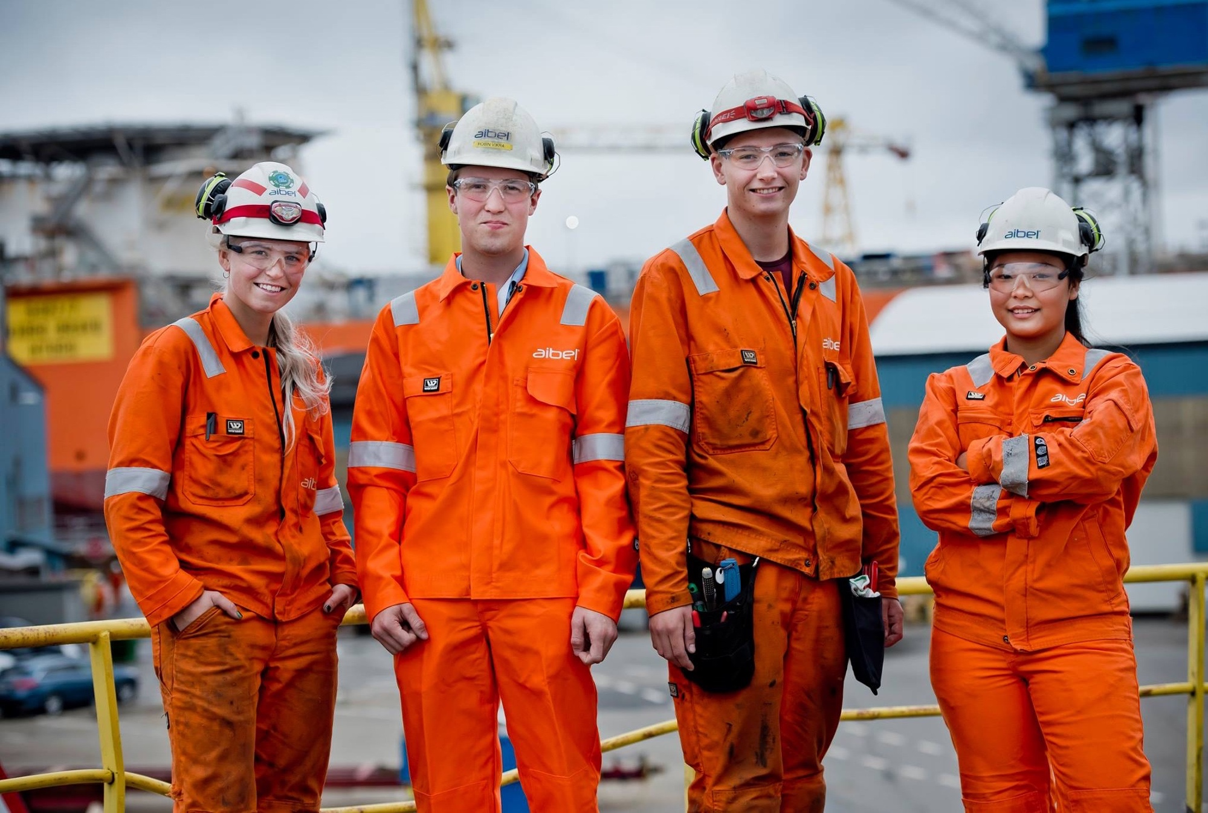
Working safely
should be easy
By learning from normal work we can improve work conditions and strengthen our barriers, reducing the occurrence and potential consequence of errors.
Notes:
Message
Those who carry out the work are not the problem, people are problem solvers, and those who do the work can help us gain better insight into that context and the conditions that can increase risk of an incident.
By learning from normal work, we can both prevent incidents by removing error traps so that it becomes easier to work safely, and put in place measures that strengthen the barriers so that the consequences of the errors that do occur are not serious.

Slide 21
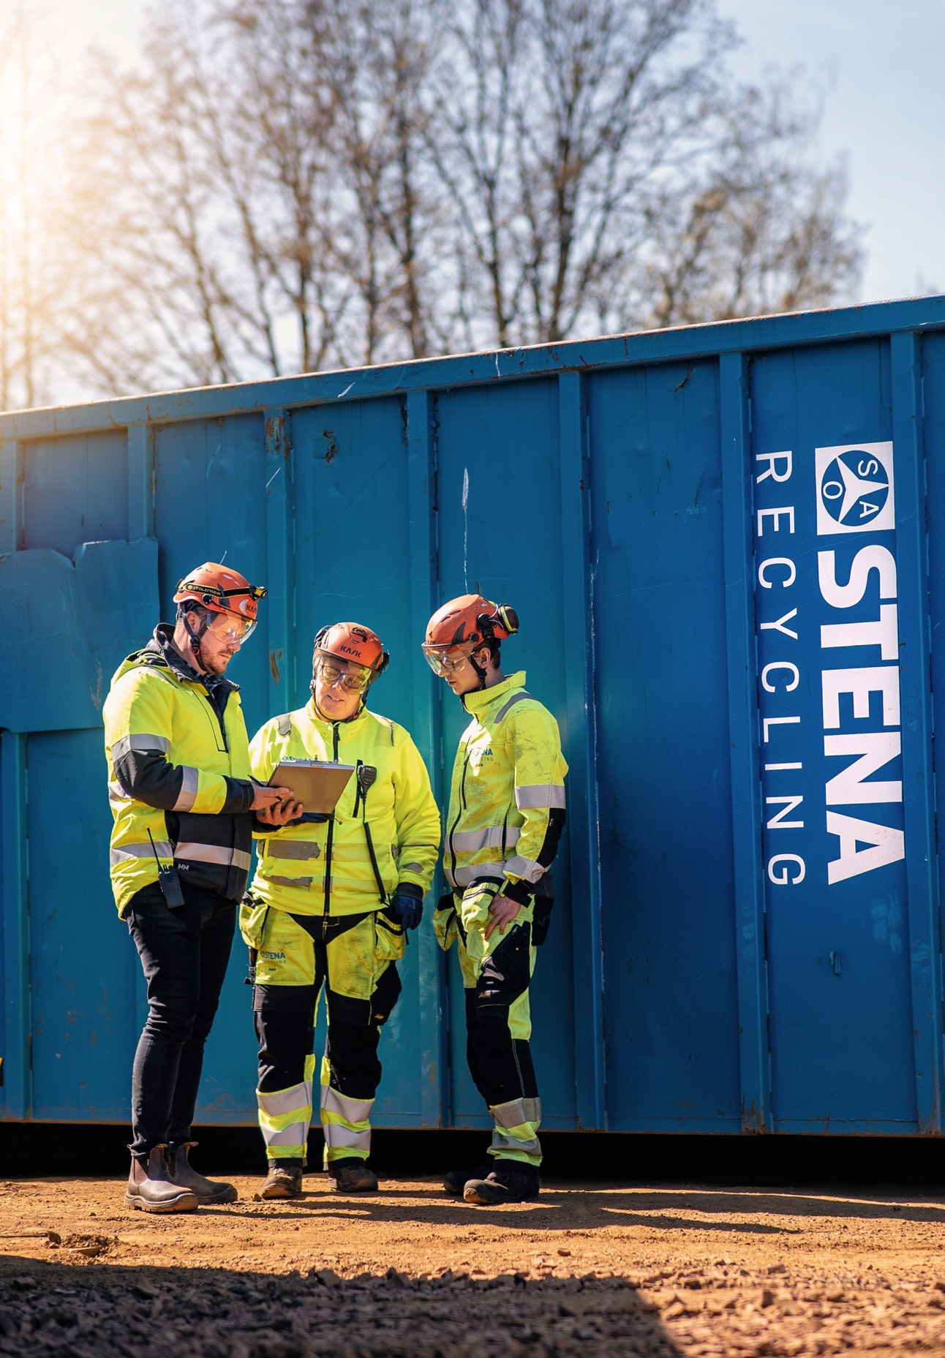
HOW TO LEARN FROM NORMAL WORK:
Identifying and understanding error traps
To identify error traps we have to understand how the job is actually done and what can make it difficult.
Be present where the job is planned, carried out and evaluated
Focus on dialogue and learning, rather than blame
Be curious
Ask open questions and listen actively
Respond constructively to deviations and undesirable conditions
Notes:
Message
What questions do we ask to identify and understand the challenges that can get in the way of working safely and what is needed to solve these?
How do we create the necessary trust for those who are about to carry out a job to report wrongdoing and deviations from plans or requirements? We cannot handle something we are not aware of or familiar with.
- We must be present where the work is being done and understand what makes it difficult for people.
- When undesirable situations arise, we must use these as an opportunity to gain insight to learn and improve. Avoid blaming others.
- In order to learn and improve, we must listen and ask open questions. We should assume that those who do the work knows best. Good questions to ask: "Can you explain this job to me?", "What makes this job difficult?", and "What would help you do the job?"
- How leaders respond to bad news matters a lot. We must create the necessary safety so that everyone dares to speak up about wrongdoing and deviations from plans or requirements. Withholding information is a human reaction if people believe that they will be singled out as a scapegoat or punished. What we are not aware of, we cannot learn from or handle.

Slide 22
A new way of thinking; a new way of speaking
By adjusting the way we speak, others will feel safer and the dialogue will become more open.
This will give you better insights into the conditions behind what people do.
FROM:
TO:
Who was responsible for what happened?
The people doing the job have to be fully present.
It’s about following the rules.
What are the risks?
I can see that you’re using the wrong equipment.
Are you following the work process?
Shouldn’t you rather have done it like this?
What conditions contributed to this happening?
Leaders need to understand what gets in the way of working safely.
If it is difficult to follow the rules, we have to talk about why.
What are the risks, and what makes this task difficult?
Can you explain this job to me?
What makes this job difficult?
What would help you do this job?
Notes:
Open-ended questions increase willingness to share. The questions provide more insight and learning, and assume that those who are closest to the execution of the job know best. The ability to ask good questions is important to communicate effectively. Open-ended questions give us details we don't get through typical "Yes / No" questions.

Slide 23
HOW TO LEARN FROM NORMAL WORK:
Use dialogue
Examples of questions to ask:
What experiences do we already have with this type of job?
What are common challenges in this type of job?
Are the requirements for this job easy to comply with? (If not: Why not?)
Is there anything about the job that is new, unknown or unpredictable?
Is there a specific part of the job where errors can easily occur?
Include the questions in established tools and conversations such as safe job analysis (SJA) and pre-job conversations.
Notes:
About this slide
The most important point is that these kinds of questions should be integrated into established tools and conversations, for instance, Safe Job Analysis (SJA) and pre-job conversations, to strengthen and improve existing practice.

Slide 24
HOW TO LEARN FROM NORMAL WORK:
Use the hierarchy of
controls actively
High
ELIMINATION
First, try to remove the error trap.
If that is not possible:
Can we replace the existing solution?
Can we find a better technical solution?
Can we organise the work differently?
Measures at the individual level are most vulnerable to mistakes and errors.
SUBSTITUTION
TECHNICAL MEASURES
Effect
ORGANISATIONAL MEASURES
PERSONAL
Low
Notes:
Message
When it comes to measures, we tend to focus on the individual level. But these measures are also most vulnerable to errors and wrongdoing. In order to be able to "fail safely", we need to see if we can identify measures at system level.

Slide 25
SUMMARY
1. Rules and requirements
are not enough
2. People make mistakes
3. Focus on blame prevents learning
Safety in the industry has improved over time, but the improvement has slowed and the curve is flattening.
All people make mistakes. Our choices and actions are influenced by the conditions around us. We need to focus on the systems around the people.
Focusing on blame reduces trust and increases fear of consequences. People avoid speaking up, and we become less familiar with conditions that require improvement.
6. Learn from normal work
5. Identify the error traps
4. Variation in work is natural
Many of the error traps that become visible after an incident are also present when the job is going well.. We must learn from normal work before an incident occurs.
Error traps are conditions that make it harder for us to follow requirements and procedures and work safely. We need to understand how the job is done and what can make it difficult.
Work is carried out under varying conditions, we make adjustments to solve the job. The gap between procedures and practice increases the risk of incidents.
7. Use open dialogue
8. Use the hierarchy of controls
Use open dialogue to identify and understand error traps. Be present, ask open questions, and focus on learning. Respond constructively to deviations and unwanted situations.
View learning and improvement from a systems perspective and use the hierarchy of controls actively in managing error traps. Measures at the individual level are most vulnerable to mistakes and errors.
25
Notes:
About this slide
The slide provides a brief summary of the main points you talked about in this presentation.

Slide 26
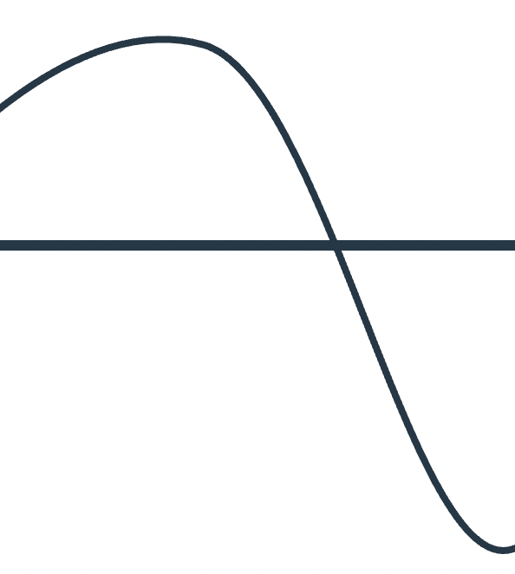
SUMMARY
Get to know the variation in work, so you can identify error traps and reduce the gap from procedure to practice.
Be present and be curious
Build trust
Ask open questions
Invite people to join the conversation
Understand what is going on
Learn to recognise signs of things that require attention
Respond constructively to deviations and unwanted conditions
Improve together​
Share learning

Slide 27
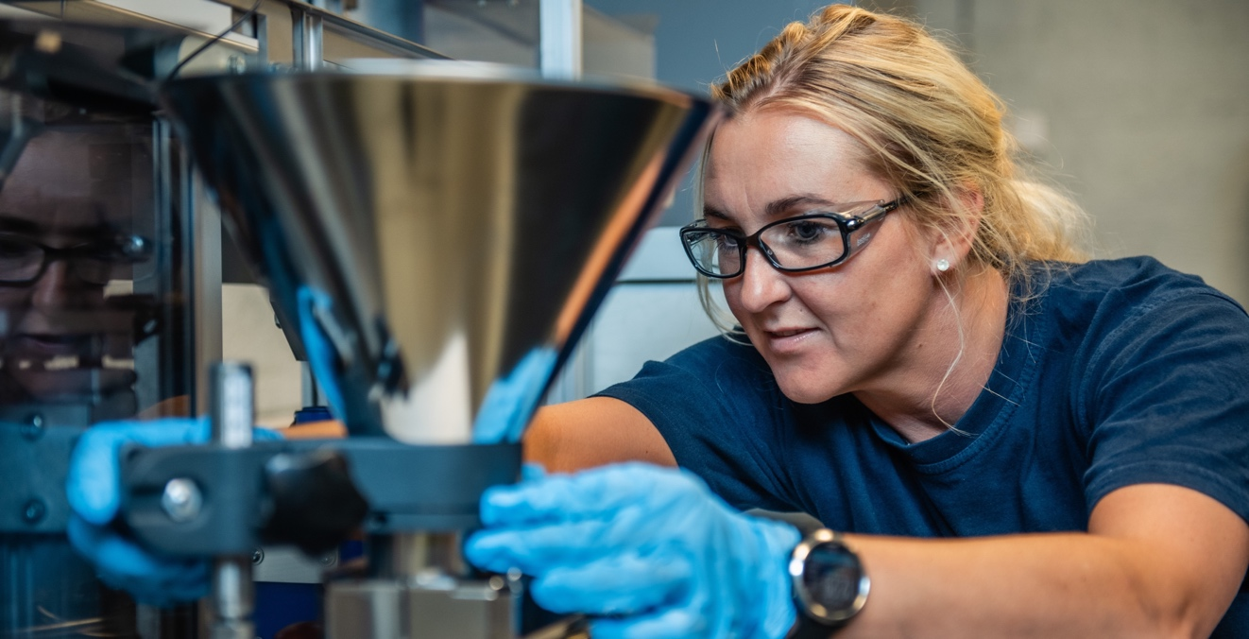
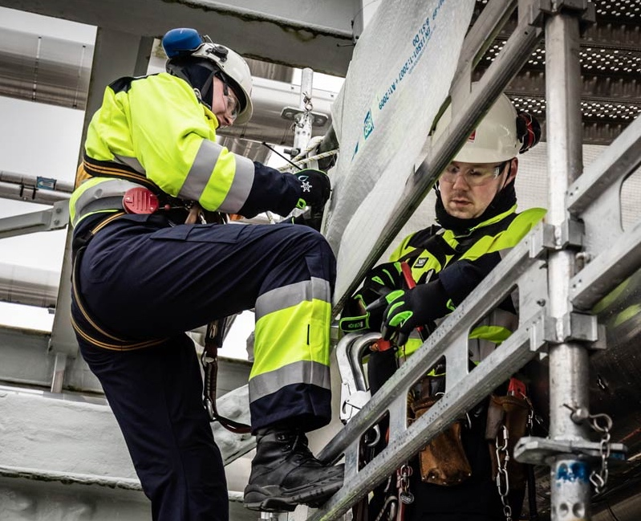
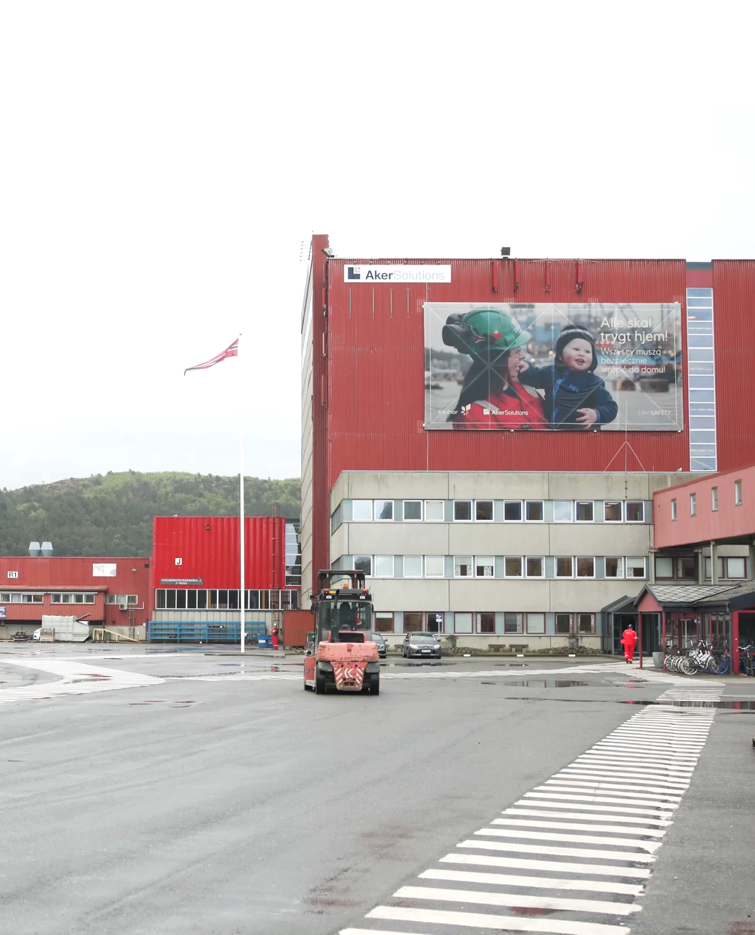
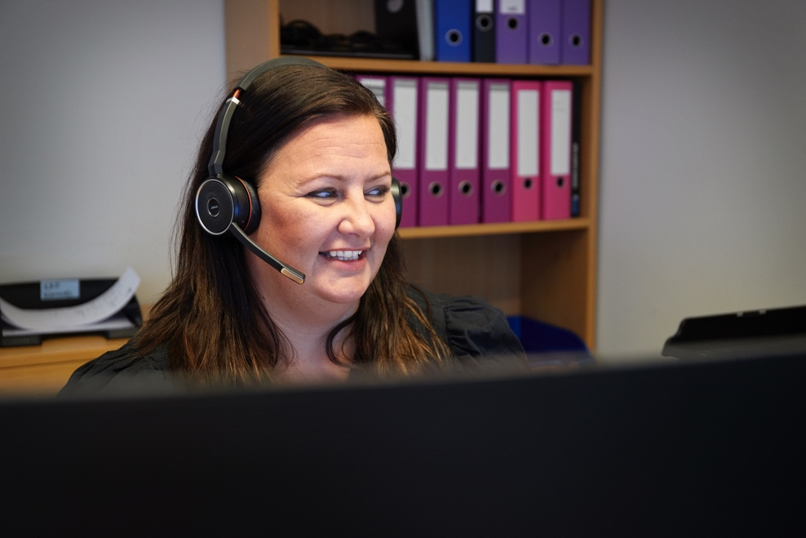
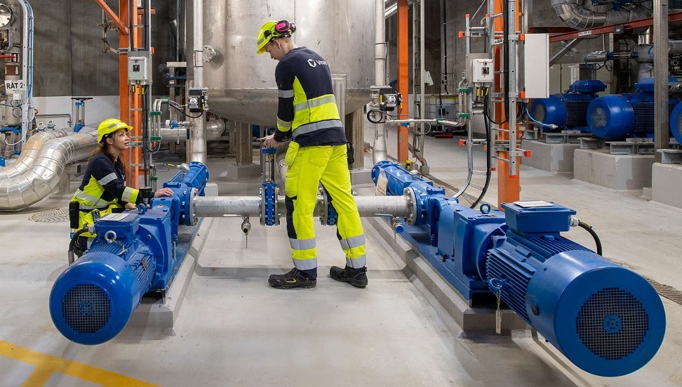
Fix the work, not the worker!

